Slide 1
Text generation using Bi-directional LSTMs
Topics in Deep Learning Project
Aiswarya Sriram - 01FB16ECS036
Aman Bhat T - 01FB16ECS052
Aneesh Padur Bhat - 01FB16ECS056

Slide 2
Problem Statement
Text sequence generation using bi-directional LSTMs.
Text generation is a subfield of natural language processing. It leverages knowledge in computational linguistics and artificial intelligence to automatically generate natural language texts, which can satisfy certain communicative requirements.
In this project we implement the text generation algorithm using bi-directional LSTMs. Bi-directional LSTMs generally converge faster than conventional LSTMs and is more accurate with respect to empirical tests.

Slide 3
Dataset
10 stories from the NLTK Gutenberg dataset
42K sentences
1M sequences
We are using only 50K sequences

Slide 4
Approach
Create wordlist containing entire dataset’s words
Create dictionary with words in alphabetical order and create vocabulary by storing each word along with its index in the dictionary.
Training data consists of 2 lists:
Sequences - Sequence of words for training(length = 30)
Next_words - Target word for each sequence in Sequences
Convert these lists to matrices X and Y
X [num_of_seq * num_of_words * vocab_size]
Y [num_of_seq * vocab_size]
Both X & Y are 1-hot vectors indicating each word’s position in the vocabulary.
This is sent to the bi-directional LSTM model of size 256 with ReLU activation unit, followed by a dropout layer with probability = 0.6

Slide 5
Approach contd.
This is then attached to a dense layer of size of vocabulary followed by a softmax activation layer. We used Adam optimiser and calculated loss using categorical cross entropy.
Batch size is 32
Model checkpoint to save the training automatically
Early stop, loss doesn’t improve after 4 epochs.

Slide 6
Word Prediction
Seed input – Sequence of words (length = 10)
Matrix providing the probability for each word from the dictionary to be the next one in the given seed sentence.
Pick out the most probable word as the next word prediction
Append it back to the seed sentence to generate further words

Slide 7
To improve the word prediction we introduce a sampling function which uses a new parameter “temperature”.
If temperature=1, the words are chosen based on their probabilities of being the next word.
If temperature>>1, the range of probabilities is shortened i.e. the probabilities for all words to be chosen increase, introducing more variety.
If temperature is close to 0, small probabilities will be avoided and hence less words will be picked-up from the vocabulary.

Slide 8
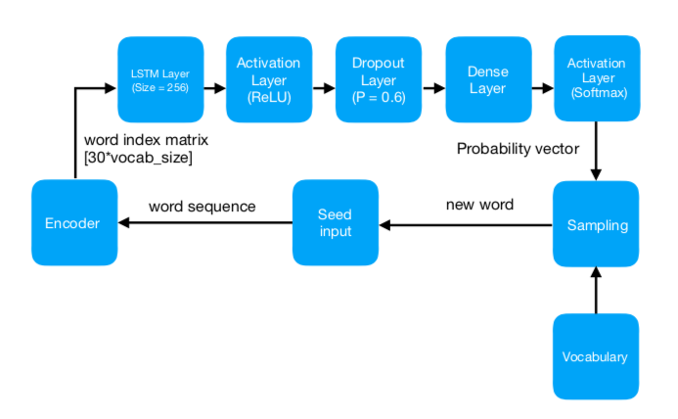
Architecture

Slide 9
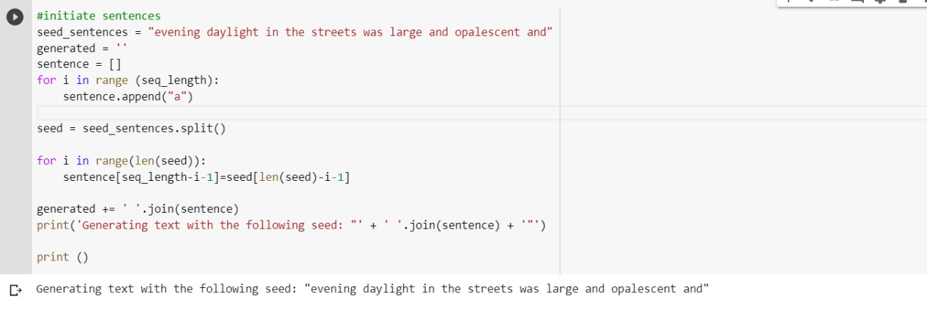
Results

Slide 10
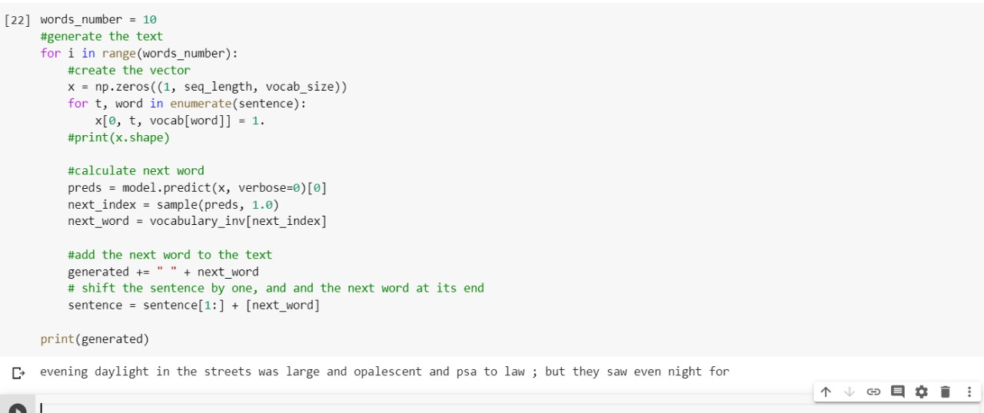
Results contd.

Slide 11
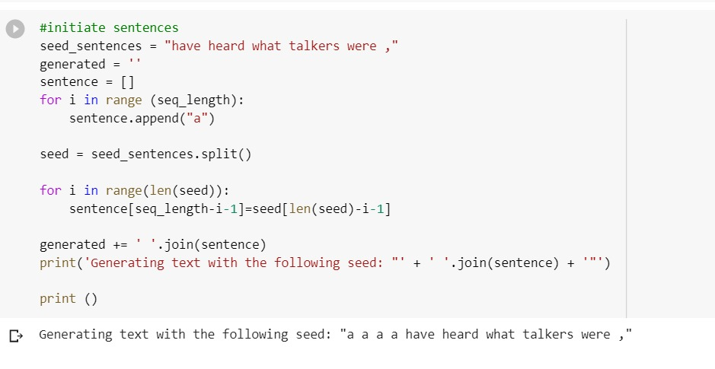
Results contd.

Slide 12
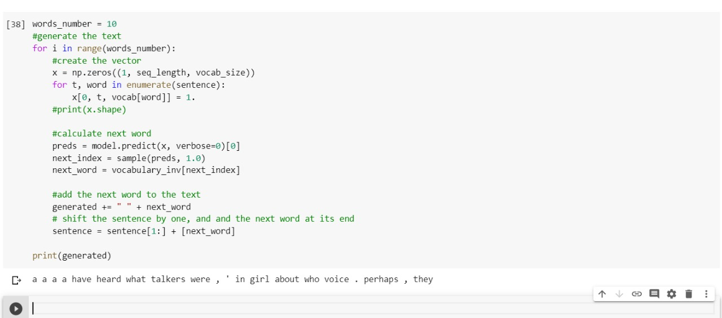
Results contd.

